Slide 1
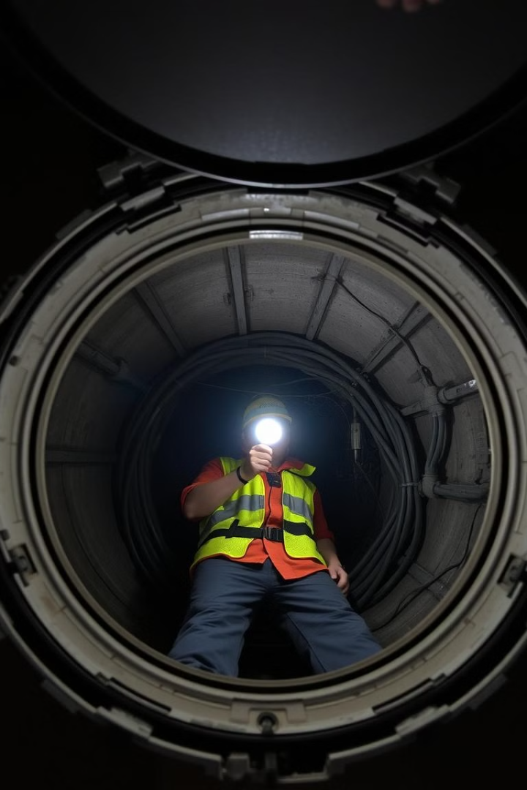


IoT Based Manhole Monitoring System
This presentation explores the challenges of traditional manhole management and introduces an innovative IoT-based solution to enhance safety and efficiency.
by KrnkReddy

Slide 2
The Problem: Existing Manhole Management Challenges
Safety Risks
Inefficient Maintenance
Data Scarcity
Limited visibility inside manholes, leading to potential hazards for workers and residents.
Manual inspections are time-consuming and often reactive, delaying crucial maintenance.
Lack of real-time data about manhole conditions, hindering proactive decision-making.

Slide 3

Proposed Solution: IoT Sensor Network Architecture
Sensors
Gateway
Cloud Platform
Various sensors deployed inside manholes, gathering data on key parameters.
Collects data from sensors and transmits it to the cloud platform.
Stores and processes data, enabling advanced analytics and visualization.

Slide 4
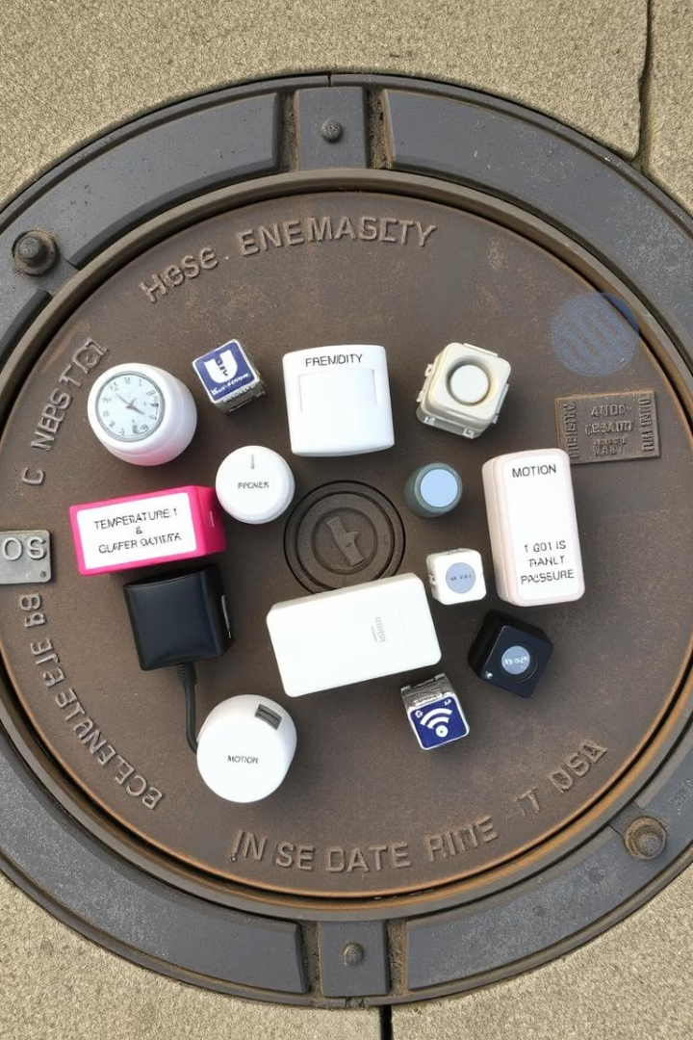



Sensor Technology: Types, Placement, and Data Collected
Temperature
Gas Detection
Water Level
Detects potential overheating due to faulty equipment or external conditions.
Monitors for hazardous gas leaks, triggering alarms for immediate action.
Tracks water accumulation, indicating potential flooding or leaks.

Slide 5
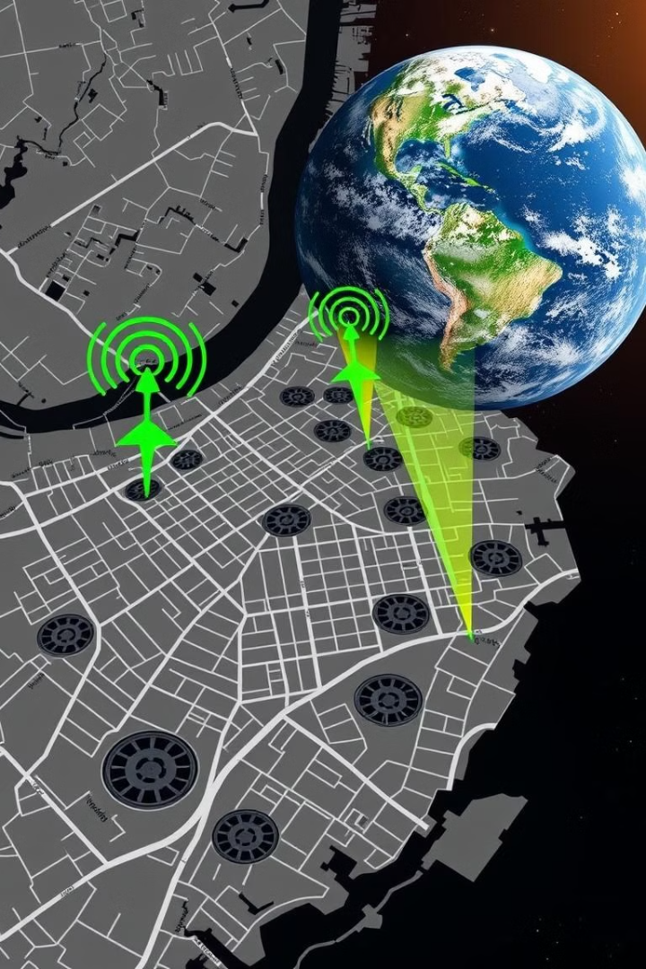
Communication & Data Transmission: LoRaWAN Connectivity
1
Sensor Data
Sensors collect data on temperature, gas levels, and water levels.
2
Gateway
Data is transmitted wirelessly to the gateway using LoRaWAN technology.
3
Cloud Platform
Gateway relays data to the cloud platform for analysis and storage.

Slide 6

Data Analytics & Visualization: Cloud-Based Dashboard
Data Collection
Data from sensors is aggregated and stored in the cloud.
Data Processing
Algorithms analyze the data, identifying patterns and anomalies.
Visualization
Dashboard provides intuitive visualization of data, enabling informed decision-making.
Notes:
We're using a cloud-based dashboard for data analytics and visualization. First, data from various sensors is collected and stored in the cloud. Then, algorithms process this data to find patterns and anomalies. Finally, the dashboard visualizes the data in an easy-to-understand format. This helps us make better, data-driven decisions.

Slide 7

Case Study: Real-World Implementation & Results
1
Deployment
2
Results
The IoT system was deployed in a large metropolitan area with a high concentration of manholes.
The system successfully detected and prevented multiple safety hazards, including gas leaks and water leaks.
3
Efficiency Gains
Maintenance costs were reduced significantly through proactive monitoring and targeted interventions.

Slide 8



Benefits & Future Scope: Improved Safety & Efficiency
Enhanced Safety
1
Minimizes risks to workers and residents by providing real-time insights into manhole conditions.
Reduced Costs
2
Optimizes maintenance schedules and prevents costly emergency repairs.
Improved Efficiency
3
Enables proactive monitoring and management of manhole infrastructure.

